Slide 1
LF 101 (Part II) Slide 2/13
26th Feb, FRDAY 2016
Laws of Inheritance
1/22

Slide 2
RECAP
What is assumed here?
Assumption:
For each trait there is one pair of alleles
Law of segregation
Alleles (factors) representing a given trait segregate (separate) during gamete formation, and randomly unite at fertilization.
An interpretation based on first & second law of probability:
Each gamete receive only one of the two alleles (factors)
How this inference was drawn?
How to read ? Example
http://en.wikipedia.org/wiki/Mendelian_inheritance
2/22

Slide 3
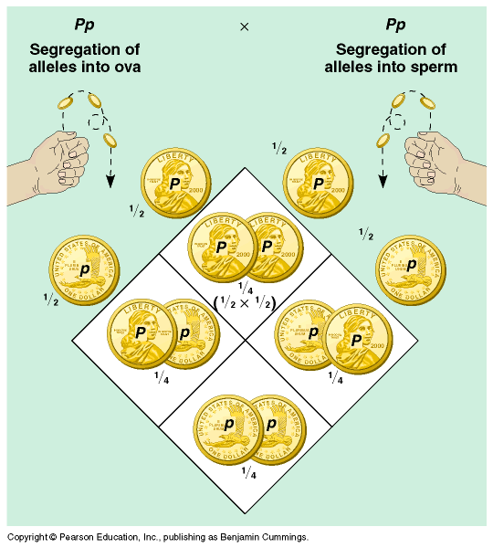
RECAP
First law of probability
First law of probability
Second law of probability
Second law of probability
3/22
The First Law of Probability states that the results of one chance event have no effect on the results of subsequent chance events.
Second Law of Probability, which states that the probability of independent chance events occurring together is the product of the probabilities of the separate events.

Slide 4
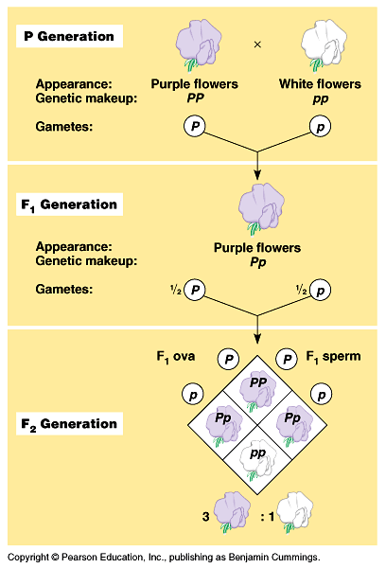
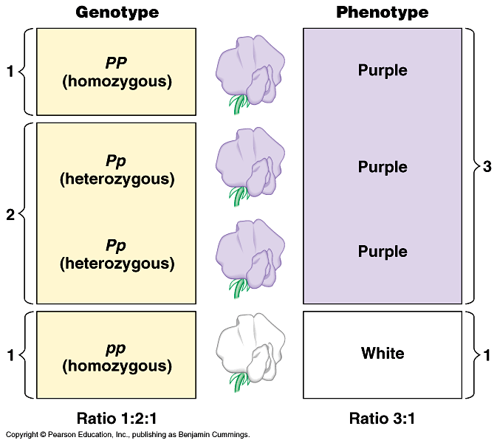
This is also called a monohybrid cross. Why??
RECAP
4/22

Slide 5
RECAP
Test cross
Purple X White
Pp pp
Explain the design/purpose of this cross
??
What does this cross reveal?
5/22

Slide 6
Your home work
Explain why did Mendel took two contrasting factors to demonstrate this rule of inheritance, namely, the law of segregation?
What will be the consequence if these factors do not segregate over succeeding generations ?
What is the modern term for Mendelian factors?
Why should these factors be in pairs at all?
6/22

Slide 7
Let’s consider inheritance of two different pairs of factors
What does R and r mean?
Which one is dominant?
Character : texture of the seeds
Traits smooth (R ) and rough ( r)
Character : color of the seeds
Traits yellow (Y) and green (y)
If a plant is true breeding smooth and yellow – how can we represent its genotype?
RRYY
If a plant is true breeding rough and green – how can we represent its genotype?
rryy
7/22

Slide 8
What will be the consequence if a true breeding smooth and yellow plant is crossed with another true breeding plant which is rough and yellow?
P1
RRYY X rryy
8/22

Slide 9
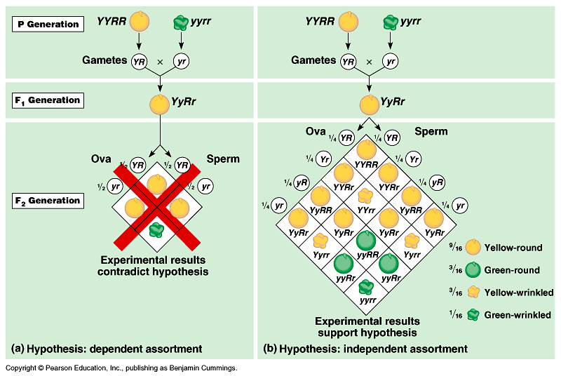
First, find the types of gametes that are possible
Second, speculate the outcome if factors of original parent segregate together
9/22
These results demands explanation based on an another law of inheritance: namely, the law of independent assortment
Notice, however, that this inheritance follows the law of segregation

Slide 10
Law of Independent assortment
(This law tells how different Mendelian factors are distributed following segregation)
The Law of Independent Assortment states that alleles of different genes assort independently of one another during gamete formation.
Alleles: each of two or more alternative forms of a gene that arise by mutation
10/22

Slide 11
Your homework:
Explain the applications of the first and second laws of probability during the formation of the gametes of the F1 parent
P1
F1
F2
The dihybrid ratio
11/22

Slide 12
What is the consequence of the operation of law of independent assortment in our own inheritance ?
12/22

Slide 13
New Questions
How many factors are there in a pea plant?
Are these factors real?
Where are they located ?
13/22

Slide 14
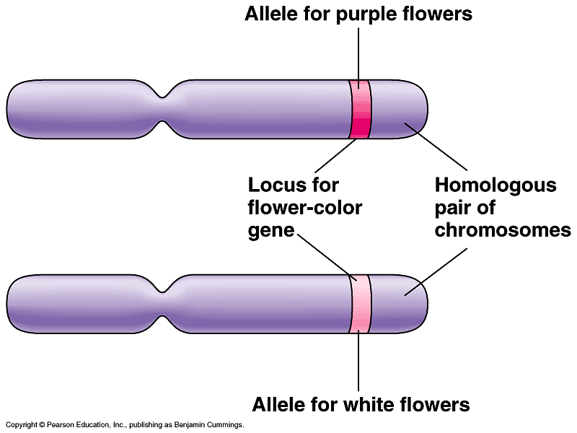
New Topic
Chromosomal basis of Mendelian inheritance
Mendel explained inheritance in pea in 1865 – it was not called a law in those days – it was hardly noticed. The physical basis of Mendelian inheritance became evident when chromosomes were discovered and their transmission in somatic cells (by Mitosis) and Gametes (Meiosis) was understood in the early 1900s
Summary of our current understanding
14/22

Slide 15
How many sets of chromosome do we carry?
2. How many versions (alleles) of a gene can we carry if every chromosome is in pair?
3. What happens during the gamete formation (meiosis) ? Do the gene pairs stay together?
4. What happens then to the paternal and maternal sets of genes that we inherited ?
15/22

Slide 16
Use the following words to complete the sentence below allele(s), diploid, gamete(s), gene, haploid
A ______organism contains two _____ of each ______ in all cells except its _________which are _________ and contain only one.
16/22

Slide 17
Use the following words to complete the sentence below. dominant, homozygous, non-identical, heterozygous, identical
All non-reproductive cells contain two alleles of each gene. When those alleles are ____________, the cell is said to be _____________. When those alleles are _____________, the cell is said to be _______________, in which case the cell’s (or organism’s) phenotype is dictated by the _____________ allele.
17/22

Slide 18
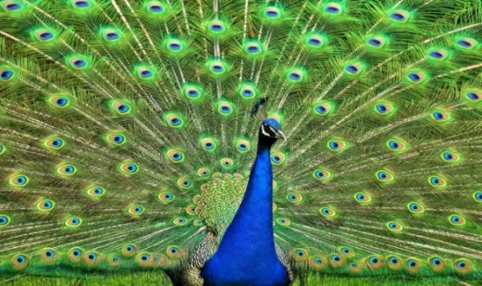
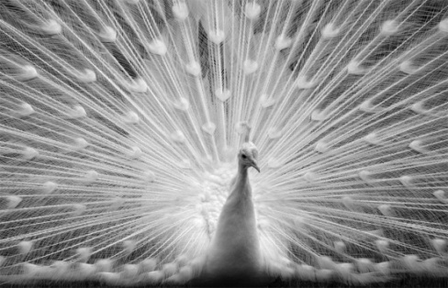

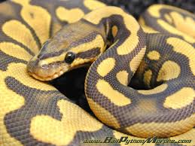
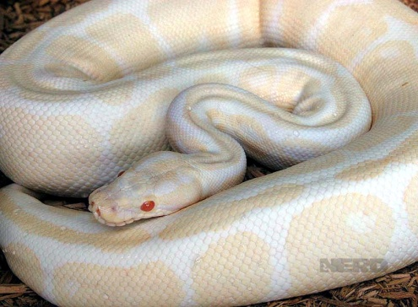
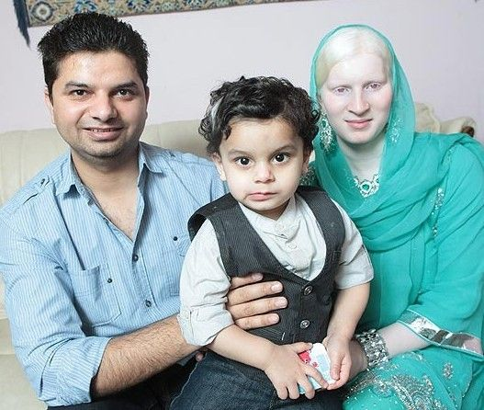
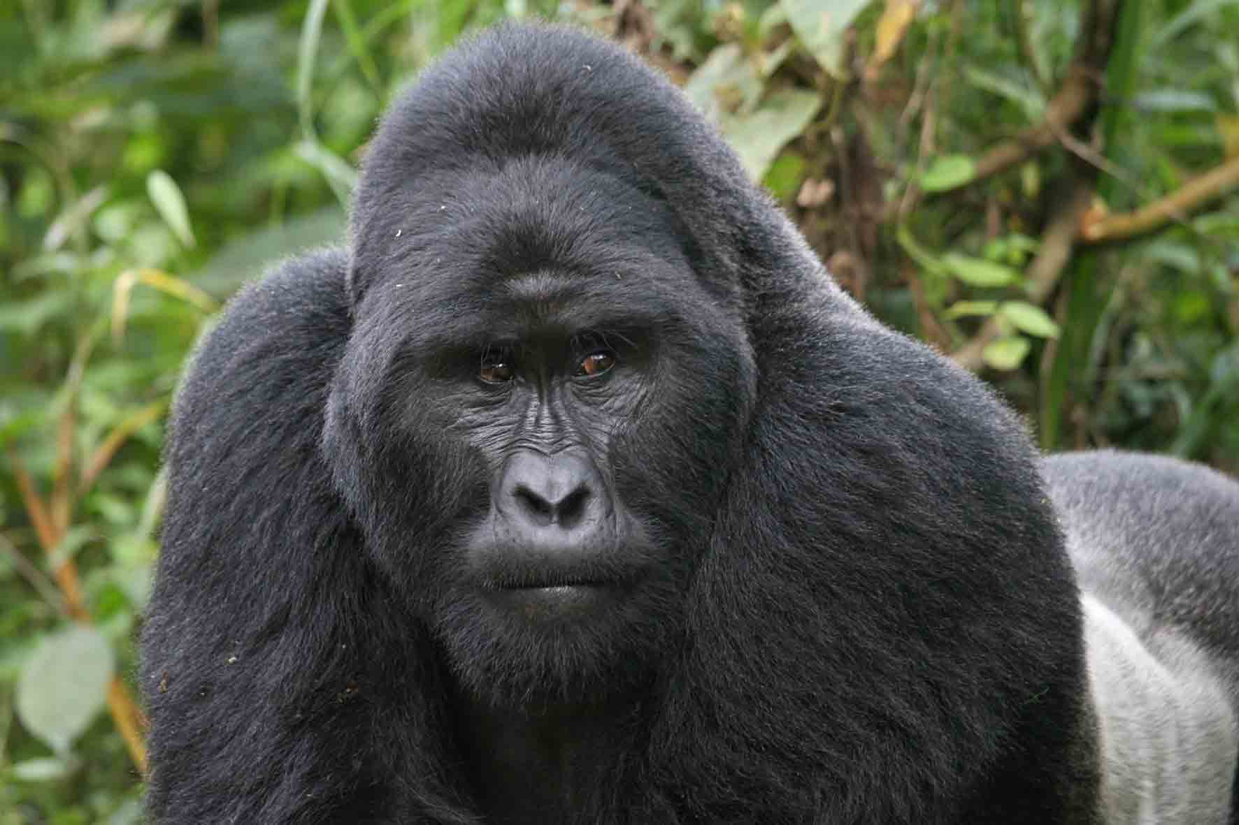
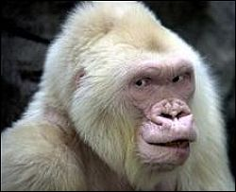

Some relevant information
https://www.pinterest.com/pin/445786063089901718/
http://www.healthline.com/health/albinism#Types2

Slide 19
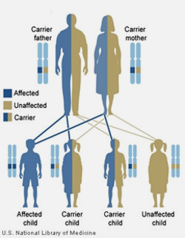
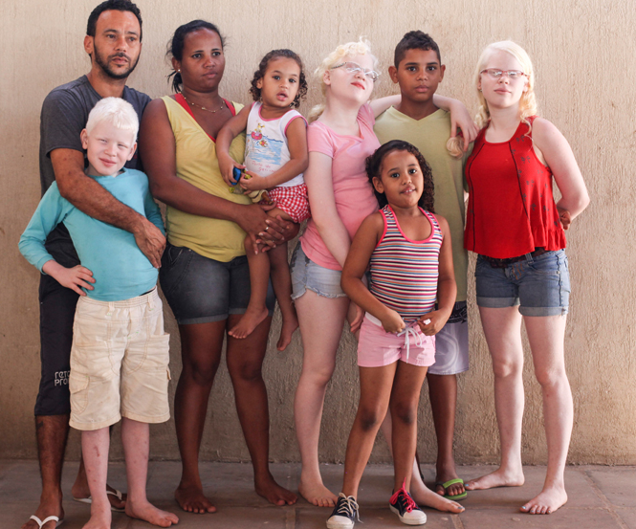
Some relevant information
My wife's three uncles and an aunt are albinos but her father as well as her mother are not. I too don't have any family history in this matter. Is there any probability that my son or daughter will be albino?
-A curious adult from India
Further reading :
http://genetics.thetech.org/ask-a-geneticist/odds-child-albinism

Slide 20
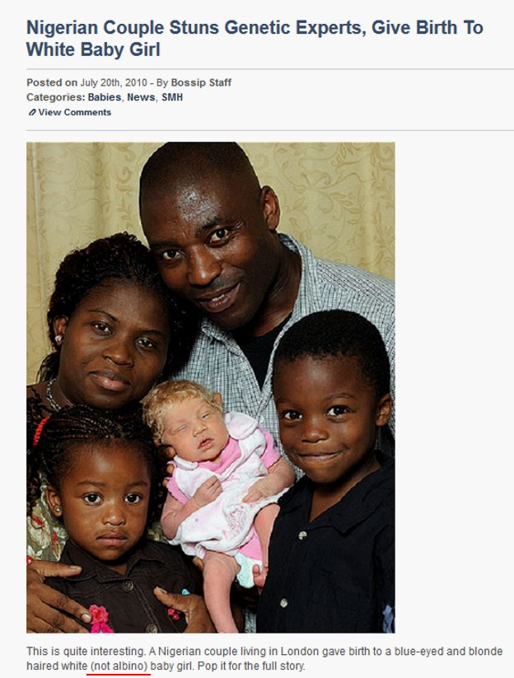
Some relevant information
Some interesting headlines
http://realhistoryww.com/world_history/ancient/Misc/Roma/How_race_is_made.htm

Slide 21
Problem
The tyrosinase gene, TYR, is necessary for production of the skin pigment melanin in humans. A recessive allele, tyr, of this gene causes the most frequent form of albinism. Homozygotes (tyr / tyr) do not produce melanin, while heterozygotes (TYR / tyr) are unaffected. What is the probability that a child born to a couple, both heterozygous for (TYR/tyr) will be albino?
Your answer should be based on use of the correct symbols
Define the terms used in the above question
18/22

Slide 22
Problem
1. One gene has alleles A and a. another has allele B and b. For each genotype, what type(s) of gametes will form? Assume that independent assortment occurs.
a. AABB
b. AaBB
c. Aabb
d. AaBb
More questions?
Which one of the parental genotypes is a product of a monohybrid cross?
Which one of the parents is not a hybrid?
Answers:
Parental genotype | Gamete types formed
AABB | AB
AaBB | AB (1/2) & aB(1/2)
Aabb | Ab (1/2), ab(1/2)
AaBb | AB (1/4), Ab (1/4) aB (1/4), ab (1/4) | Explain why there are four types of gametes
Which set of gametes display evidence of independent assortment?
19/22

Slide 23
Home work
2. What will be the genotypes of offspring from the following matings? Indicate the frequencies of each genotype among
a. AABB x aaBB
b. AaBB X AABb
c. AaBb X aabb
d. AaBb X AaBb
Step 1: In each case, first identify the types gametes formed by each parent
Step 2: Place these gametes at the designated positions in a Punnett square
Step 3. Display the genotypes of the products of fusion of these various gametes in the Punnett square
Step 4. Describe the phenotypes of the genotype of the progeny and their ratios
20/22

Slide 24
Next class
Chromosomal basis of Mendelian inheritance: Meiosis – production of gametes
Somatic cell division – Mitosis
Applications of Mendelian inheritance
Also come prepared with the reading materials I would provide in advance
22/22

